Slide 1
Lecture 3:
Marx, Weber, Durkheim
Course: Introduction to Human Sciences

Slide 2
Karl Marx
(but also Fredrick Engels)
SOCIAL FORMATION
  “A social formation refers to a society (a social structure at any level such as a nation, city, business, university, or even a family) with all its complexities, as it is historically constituted. It includes all the internal contradictions that exist in a society, all emerging and disappearing tendencies in the economy and superstructure, in the social relationships that comprise these.”
  Primitive communism ---- Feudalism ----- Capitalism ------ Socialism ----- Communism
Stratification is result of specific historical processes.
Stratification is conflict-ridden, and thus has the inherent potential to change shape.

Slide 3
The Marxist Approach
MAIN IDEAS:
Materialism
  “According to the materialistic conception, the determining factor is, in the final instance, the production and reproduction of the immediate essentials of life.” ~ Fredrick Engels
Marx asks:
What are the ‘productive forces’? Labour, as well as means of production (equipments, buildings, land, technologies, information etc…).
What the social relations of production? Ownership patterns, patterns of power and control…
TOGETHER, they make up the ‘MODES OF PRODUCTION’.

Slide 4
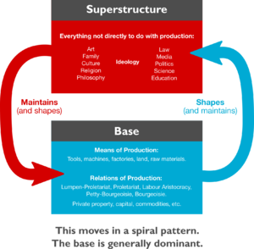
The Marxist Approach
Family structure is linked to form of property ownership
  Which itself is linked to the mode and relations of production
Property ownership is linked to form of State
  Clear causal link between the smallest social unit (emotional base of society) with social relations and State form

Slide 5
Karl Marx
(but also Fredrick Engels)
ALIENATION
Special feature of capitalist society
Humans alienated from product of their own labour
Creates alienation between humans
Alienation from self
Alienation from nature
Affects culture and family

Slide 6
Émile Durkheim
Established sociology as an academic discipline
Drew on Auguste Comte
Wanted to understand how society sustains itself; how it maintains its coherence and integrity
Scientific methods for study of society
  Identify and define different parts of society by their function in maintaining social order
Society is more than a sum of its parts
  Society is formed of individuals but each person can be seen as an individual only when society is formed

Slide 7
What IS a Social Fact?
A social fact is any way of acting, whether fixed or not, capable of exerting over the individual an external constraint
– Durkheim
Include social institutions and social activities. Statuses, roles, laws, beliefs.
External to every individual.
Coercive.
Social facts CANNOT be explained by reducing them to the level of the individual.
Examples: Divorce rate, economic growth rate, population distribution, urbanization, religious structures, caste divisions.

Slide 8
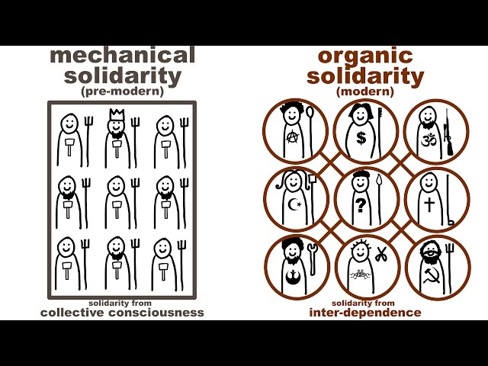
Explaining Cultural Change
    “Old order is being swept away…loss of security and predictability”
    Pre-industrial societies: Simple, unsegmented, homogenous clans. MECHANICAL solidarity based on religious beliefs, “collective consensus/conscience”, individuals SIMILAR in behavior/moral respects.
    Western industrialization: BREAKDOWN of collective conscience.
WHAT holds society together?

Slide 9
Explaining Cultural Change
    ROOTS of EVOLUTIONALISM:
    Western industrialization: BREAKDOWN of collective conscience. DIVISION of LABOUR → Increasing individualism, heterogeneity, interdependence
    NEW MORAL ORDER: Social solidarity was ORGANIC rather than MECHANICAL.
    BUT, the move from mechanical to organic solidarity was NOT AUTOMATIC. ABNORMALITIES arose.
    ANOMIE: Rootlessness, lack of regulation, lack of moral discipline.
    NEED to develop moral code/order based on occupational associations, which would provide sense of belonging/solidarity/mutual assistance.

Slide 10
Max Weber
Extended Marx and Durkheim in engagement and contestation
Focus on Capitalism and its society
Ideal-type
Method of identifying actions and interpreting their meaning
Finding patterns and locating subjectivity

Slide 11
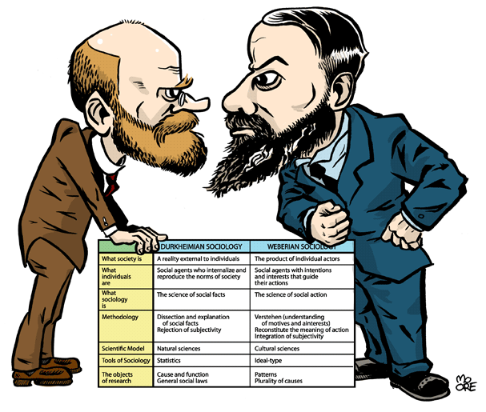

Slide 12
Weberian Approach
Weber founded ‘interpretive’ sociology. Argued that study of social action should not be purely empirical. It should try and understand (‘interpret’) the meanings and purposes that individuals attach to their actions. Rejected monocausality.
INTERPRETATIVE SOCIOLOGY
There is NO objectively “correct” meaning. Meaning depends on Context and Subjectivity, unlike empirical ‘truth’.
The dividing line between ‘objective’ (understandable) and ‘subjective’ (non-understandable) action is hazy. They are bound up together.
‘Motives’ have to be identified.

Slide 13
The Weberian Approach
“In the great majority of cases actual action goes on in a state of inarticulate half-consciousness or actual unconsciousness of its subjective meaning. The actor is more likely to “be aware” of it in a vague sense than he is to “know” what he is doing or to explicitly self-conscious about it. In most cases his action is governed by impulse or habit. Only occasionally and, in the uniform action of large numbers, often only in the case of a few individuals, is the subjective meaning of the action, whether rational or irrational, brought clearly into consciousness. The ideal type of meaningful action where the meaning is fully conscious and explicit is a marginal case…”
– Max Weber

Slide 14
The Weberian Approach
Types of social action:
Instrumentally rational: Expects/anticipants behavior of others, and acts accordingly. ‘Rational’, logical, towards one’s goals.
Value rational: Believes and acts upon a value for religious, ethical, aesthetic reason. Even if success is not anticipated.
Emotional: Follows feelings and emotions.
Traditional: Follows deeply ingrained habits.
Weber: These are PATTERNS in behavior. Modern society is moving towards more ‘instrumental rational’ behavior, in both personal and social spheres.

Slide 15
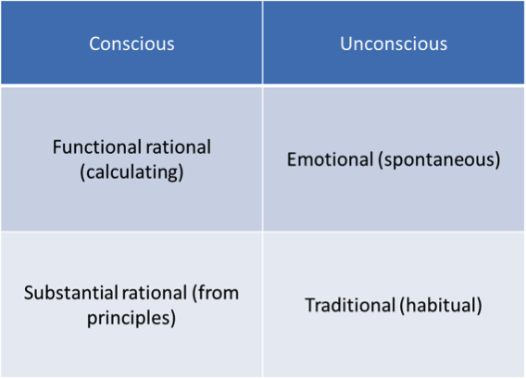

Slide 16
Max Weber
RATIONALITY
Modern society marked by universalisation of rationality
Both individual and social actions
Personal
  rational efforts aimed at achieving economic gain
Social
  Bureaucracy (rational – legal)
  instrumental rational action
  Behaviour in modern societies comes to be dictated more by goal-oriented rationality and less and less by tradition, values or emotions. Mechanisation and division of labour are also other features of this process of rationalisation.

Slide 17
Max Weber
BUREAUCRACY
Division of labour with chains of command
Duties assigned and strictly demarcated
Impersonal authority
Abstract rules
Politically neutral
“BUREAUCRATIC ADMINISTRATION MEANS FUNDAMENTALLY DOMINATION THROUGH KNOWLEDGE”

Slide 18
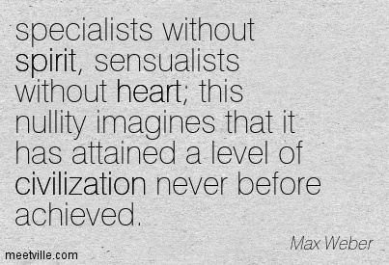
Max Weber
Bureaucracy “...results is the development of an iron cage,
A technically ordered, rigid, dehumanised society.”

Slide 19
Videos
Karl Marx’s idea of alienation https://www.youtube.com/watch?v=PZ4VzhIuKCQ&feature=youtu.be
Emile Durkheim’s idea of Social Fact
https://www.youtube.com/watch?v=uBKAaAmXY2g
Max Weber’s idea of religion as a source of capitalism
https://www.youtube.com/watch?v=tbcClUEFG3c

